Slide 1

Computer Organization & Architecture
Nilanjan Byabarta
Department of CSE
UEM Kolkata

Slide 2
Sample Questions on Last page

Slide 3
COMPUTER Architecture and Organization
Computer architecture is those attributes visible to the programmer which have direct impact on logical execution of the program.
Instruction set, number of bits used for data representation,
I/O mechanisms, addressing techniques
Computer organization refers to the operational units and their interconnections that realize the architectural specifications.

Slide 4
COMPUTER Architecture and Organization
DIFFERENCE:
Computer Organization is study of the system from software point of view and gives overall description of the system and working principles without going into much detail. In other words, it is mainly about the programmer’s or user point of view.
Computer Architecture is study of the system from hardware point of view and emphasis on how the system is implemented. Basically, throws light on the designer’s point of view.

Slide 5
Computer Architecture and Organization
Structure: The way in which the components are interrelated
Function: The operation of each individual component as part of the structure

Slide 6
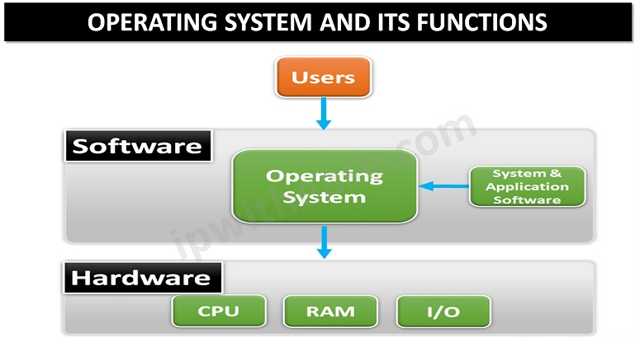

Slide 7
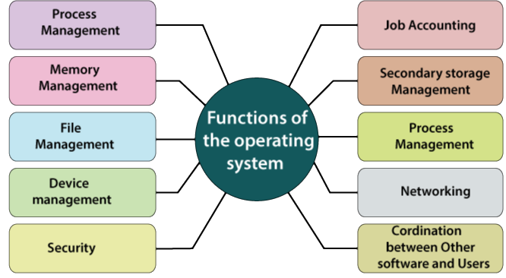

Slide 8
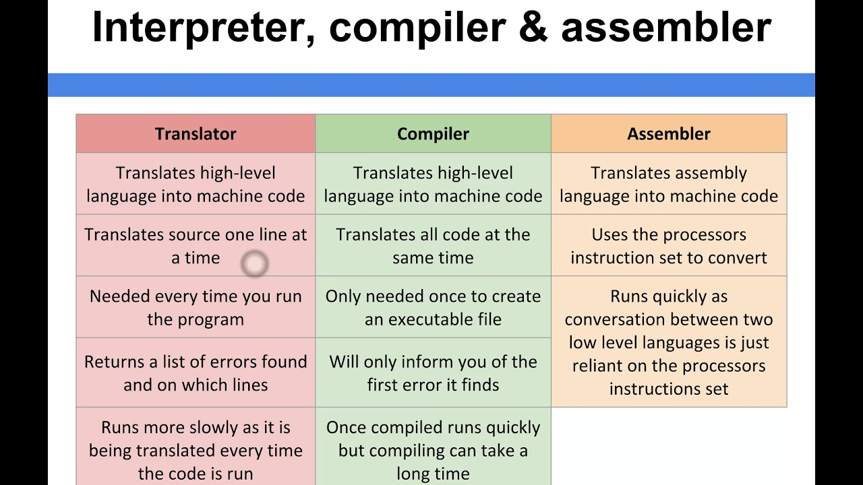

Slide 9
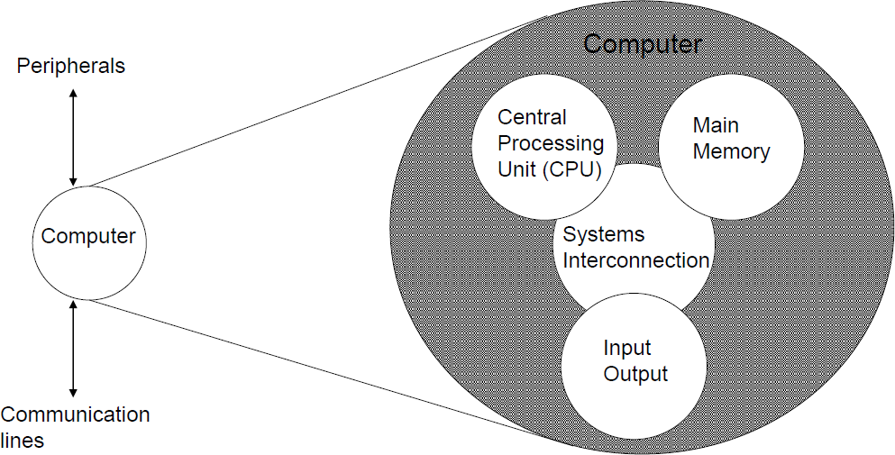
Top-Level Structure of a Computer
Figure: Main structural components of a computer

Slide 10
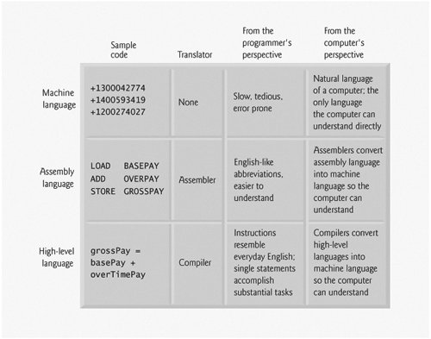
Language Structure of a Computer

Slide 11
There are four main structural components:
Central processing unit (CPU): Controls the operation of the computer and performs its data processing functions; often simply referred to as processor.
Main memory: Stores data.
I/O: Moves data between the computer and its external environment.
System interconnection: Some mechanism that provides for communication among CPU, main memory, and I/O.

Slide 12
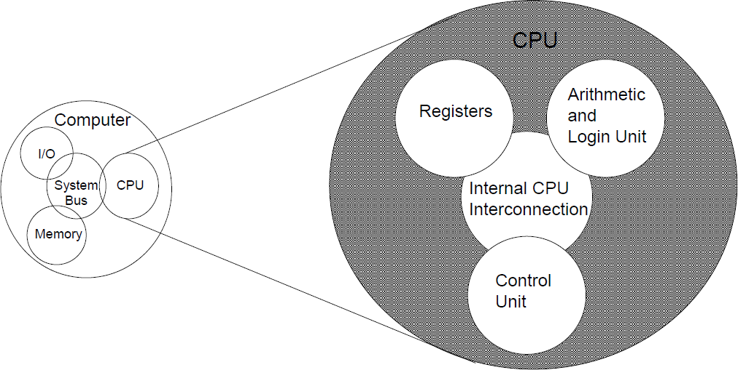
Top-Level Structure of a Computer
Figure: Main structural components of a processor/CPU

Slide 13
The major structural components of CPU are as follows:
Control unit: Controls the operation of the CPU and hence the computer
Arithmetic and logic unit (ALU): Performs the computer’s data processing functions
Registers: Provides storage internal to the CPU
CPU interconnection: Some mechanism that provides for communication among the control unit, ALU, and registers

Slide 14
Functions of a Computer
Every computer performs four basic functions:
Data processing
Data storage
Data movement
Control

Slide 15
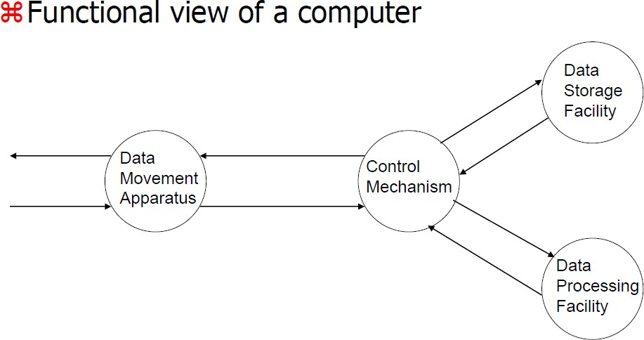
Functions of a Computer
Figure: A Functional View of the Computer

Slide 16
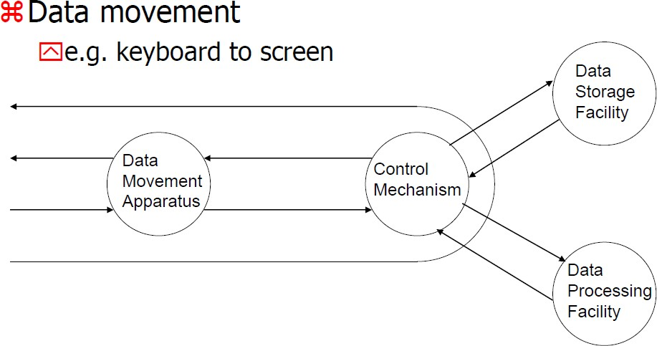
(Operation 1)

Slide 17
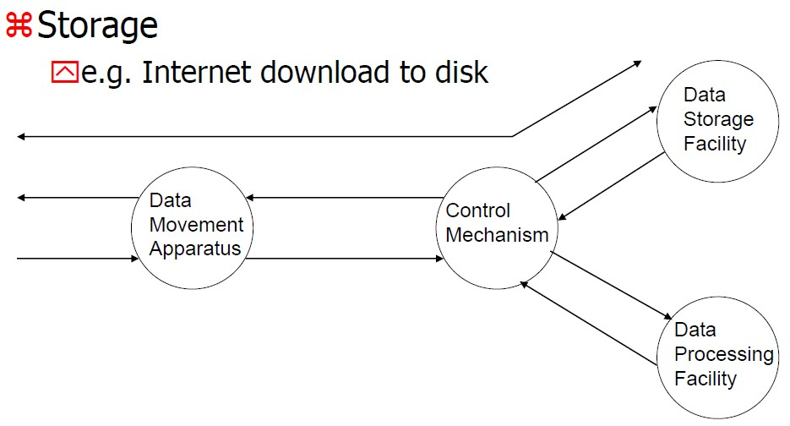
(Operation 2)

Slide 18
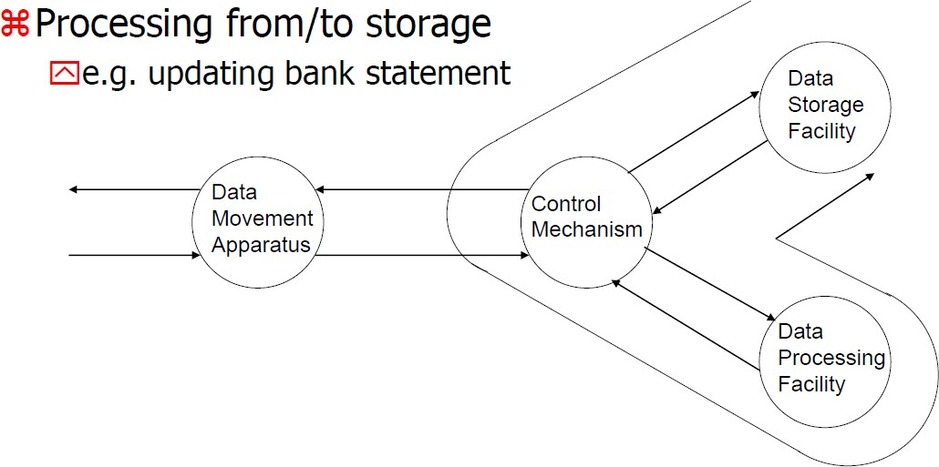
(Operation 3)

Slide 19
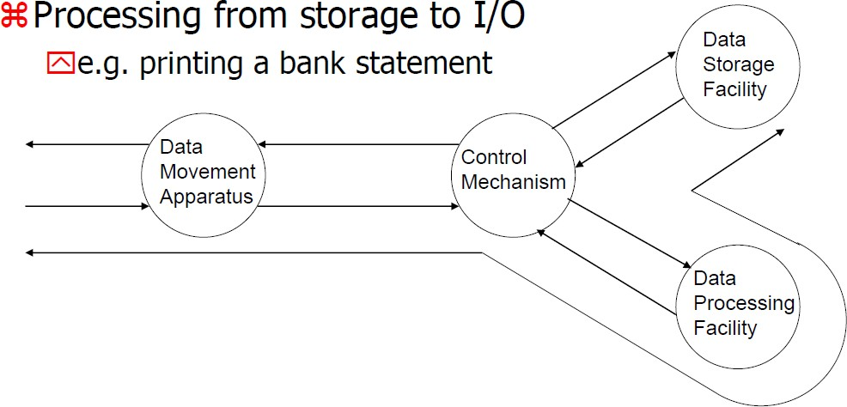
(Operation 4)

Slide 20
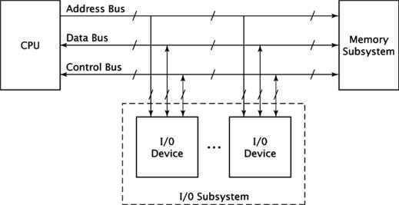
(Basic Architecture of the whole system)

Slide 21
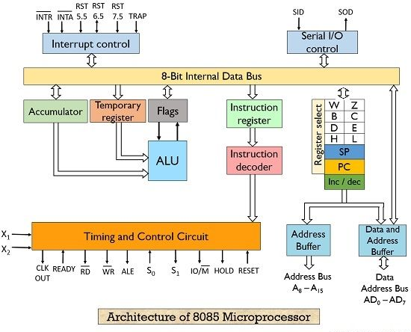

Slide 22
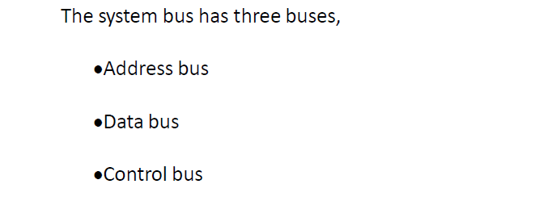

Slide 23
The uppermost bus is the address bus. When the CPU reads data or instructions from or writes data to memory, it must specify the address of the memory location it wishes to access

Slide 24
Data is transferred via the data bus. When CPU fetches data from memory it first outputs the memory address on to its address bus. Then memory outputs the data onto the data bus. Memory then reads and stores the data at the proper locations.

Slide 25
Control bus carries the control signal. Control signal is the collection of individual control signals. These signals indicate whether data is to be read into or written out of the CPU.

Slide 26
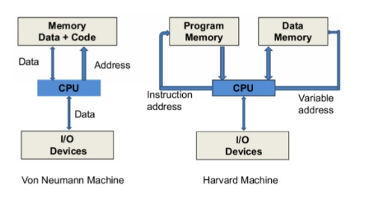

Slide 27
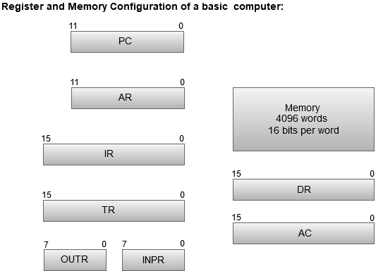

Slide 28
Register | Symbol | Number of bits | Function
Data register | DR | 16 | Holds memory operand
Address register | AR | 12 | Holds address for the memory
Accumulator | AC | 16 | Processor register
Instruction register | IR | 16 | Holds instruction code
Program counter | PC | 12 | Holds address of the instruction
Temporary register | TR | 16 | Holds temporary data
Input register | INPR | 8 | Carries input character
Output register | OUTR | 8 | Carries output character

Slide 29
Instruction cycle
The instruction cycle is the procedure a microprocessor goes through to process an instruction.
It has three phases:
Fetch
Decode
Execute

Slide 30
Instruction cycle
First the processor fetches or reads the instruction from
memory.
Then it decodes the instruction determining which instruction
it has fetched.
Finally, it performs the operations necessary to execute the instruction.
It performs some operation internally, and supplies the address, data & control signals needed by memory & I/O devices to execute the instruction.

Slide 31
Instruction cycle
the microprocessor asserts when it is ready to read data from memory or I/O device.
When READ signal is asserted the memory subsystem places the instruction code be fetched on to the computer system’s data bus. The microprocessor then inputs the data from the bus and stores its internal register.
READ signal causes the memory to read the data, the WRITE
operation causes the memory to store the data

Slide 32
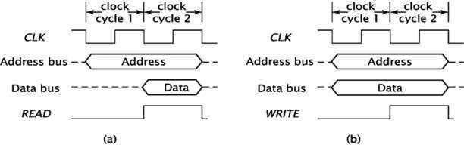
Timing diagrams

Slide 33
CPU Organization
Central processing unit (CPU) is the electronic circuitry within
a computer that carries
out the instructions of a
the basic arithmetic,
computer
logical,
program by control instructions.
performing
and input/output (I/O) operations specified by the

Slide 34
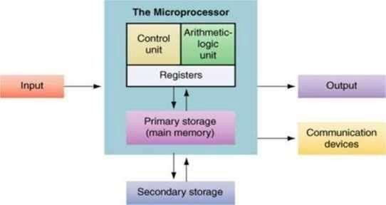
CPU Organization

Slide 35
CPU Organization
•The register section, as its name implies, includes a set of
Rregisters and a bus or other communication mechanism.
•The register in a processor’s instruction set architecture are found in the section of the CPU.
•The system address and data buses interact with this section of CPU. The register section also contains other registers that are not directly accessible by the programmer.

Slide 36
CPU Organization
The fetch portion of the instruction cycle, the processor first outputs the address of the instruction onto the address bus. The processor has a register called the ͞program counter͟.
At the end of the instruction fetch,
The instruction code from the system data bus.
the CPU reads
It stores this value
The instruction register”.
in an internal register, usually called

Slide 37
CPU Organization
The arithmetic / logic unit (or) ALU performs most arithmetic
and logic operations such as adding and ANDing values.
CPU controls the computer, the control unit controls the CPU. The control unit receives some data values from the register unit, which it used to generate the control signals.
The control unit also generates the signals for the system control bus such as READ, WRITE, IO/ signals

Slide 38
CPU Organization
Memory is the group of circuits used to store data.
Memory components have some number of memory locations, each word of which stores a binary value of some fixed length.
The number of locations and the size of each location vary from memory chip to memory chip, but they are fixed within individual chip.

Slide 39
CPU Organization
Memory is usually organized in the form of arrays, in which each cell is capable of storing one bit information.
Each row of cell constitutes a memory word, and all cells of a row are connected to a common column called word line, which is driven by the address decoder on the chip

Slide 40
Instruction types
Assembly languages instructions are grouped together based
on the operation they performed.
Data transfer instructions
Data operational instructions
Program control instructions

Slide 41
Data transfer instructions
Load the data from memory into the microprocessor: These instructions copy data from memory into a microprocessor register.
Store the data from the microprocessor into the memory: This is similar to the load data expect data is copied in the opposite direction from a microprocessor register to memory.
Move data within the microprocessor: These operations
copies data from one microprocessor register to another.
Input the data to the microprocessor: The microprocessor inputs the data from the input devices ex: keyboard in to one of its registers.

Slide 42
Data operational instructions
Data operational instructions do modify their data values. They typically perform some operations using one or two data values (operands) and store result.
Arithmetic | instructions | make up a | large part | of data
operations | instructions. | Instructions | that add, | subtract,
multiply, or divide values fall into this category. An instruction that increment or decrement also falls in to this category.

Slide 43
Logical instructions perform basic logical operations on data. They AND, OR, or XOR two data values or complement a single value.
Shift operations as their name implies shift the bits of a data
values also comes under this category

Slide 44
An isolated I/O input and output devices are treated as being separated from memory. Different instructions are used for memory and I/O.
Memory mapped I/O treats input and output devices as memory locations the CPU access these I/O devices using the same instructions that it uses to access memory. For relatively simple CPU memory mapped I/O is used.
There are three registers in ISA of this processor.
Accumulator (AC)
Register R
Zero flag (Z)

Slide 45
Addressing Modes –
The term addressing modes refers to the way in which the operand of an instruction is specified. The addressing mode specifies a rule for interpreting or modifying the address field of the instruction before the operand is actually executed.

Slide 46
Addressing mode:
it is a way to represent the address of the data.
Addressing modes:
• Immediate
• Direct
• Indirect
• Register
• Register indirect
• Displacement
• Stack

Slide 47
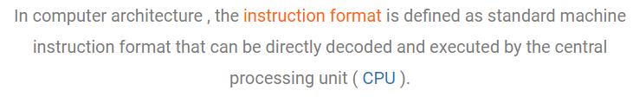



Slide 48
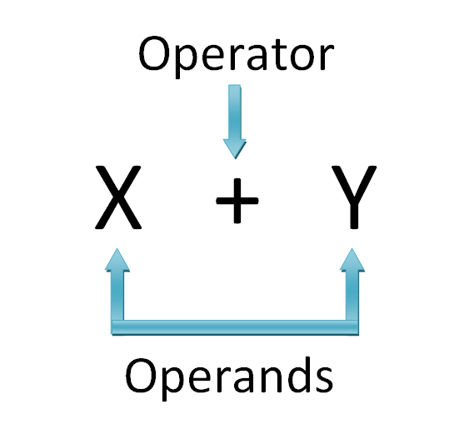

Slide 49
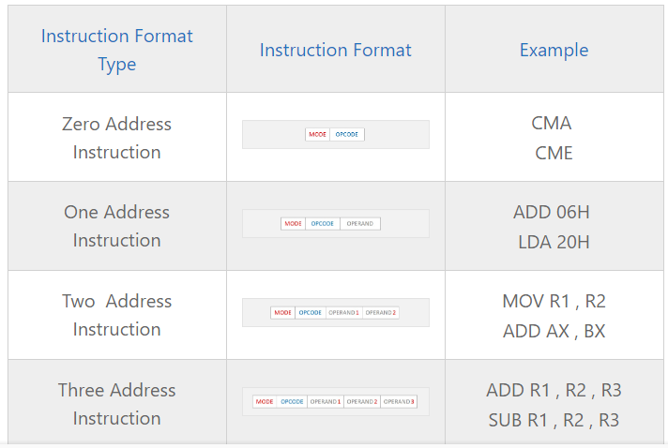

Slide 50
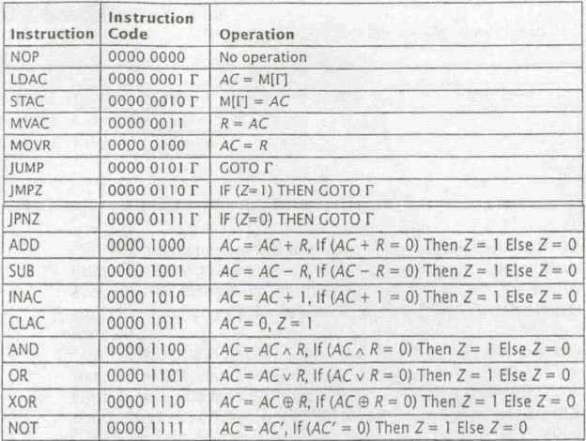

Slide 51
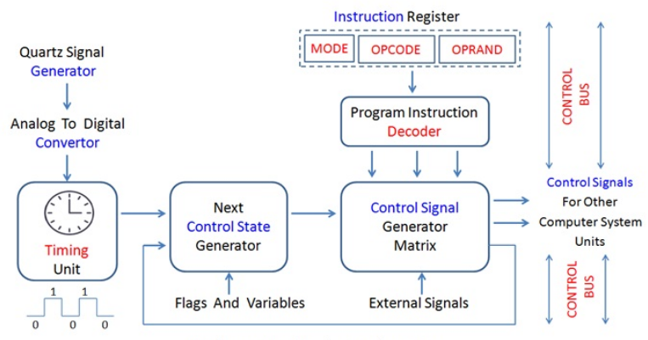

Slide 52
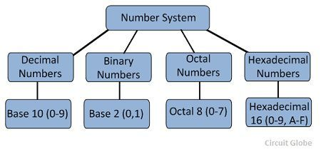
Number Systems

Slide 53
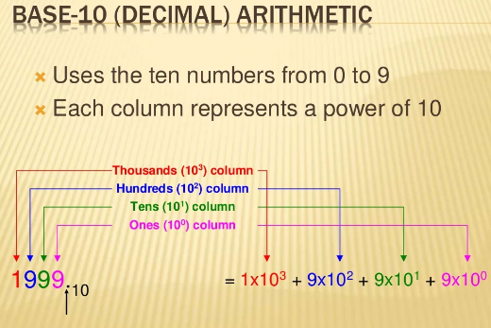

Slide 54
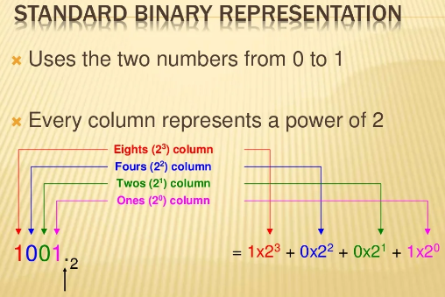

Slide 55
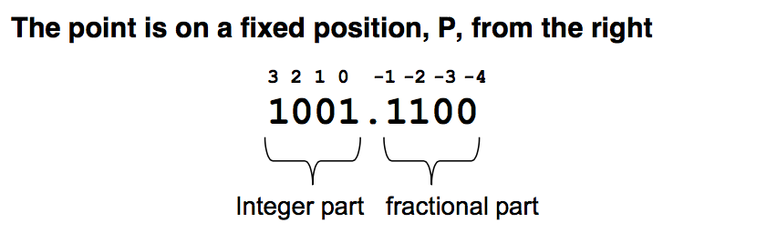

Slide 56
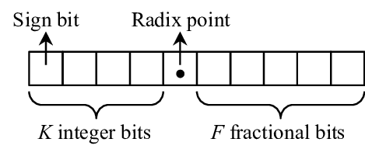

Slide 58
Floating point representation can be used to overcome the limitations of fixed point representation. Therefore, most modern computers use floating point representation to store fractional numbers in memory. It can represent very large and very small numbers precisely. It is based on the scientific notation.

Slide 59
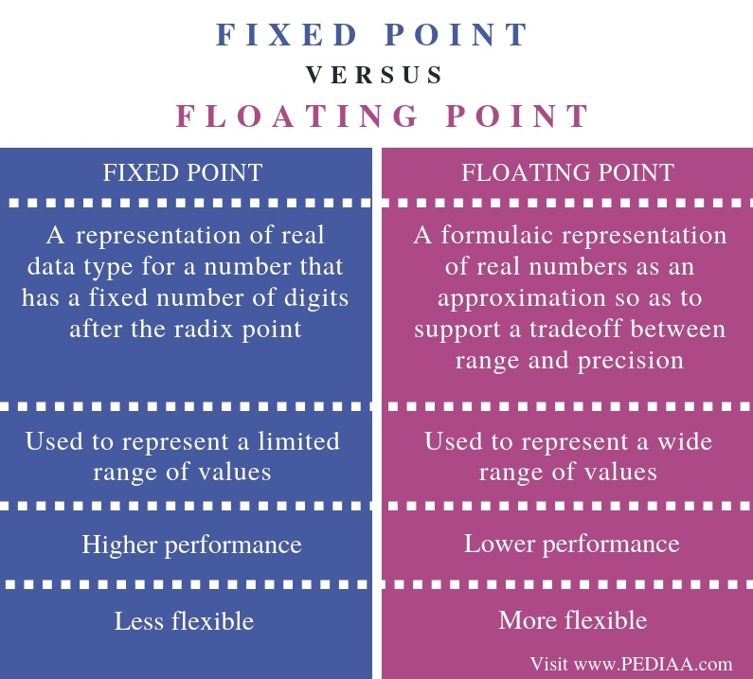

Slide 60
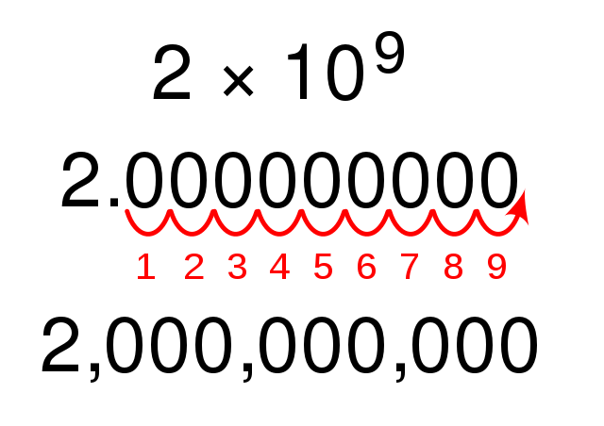

Slide 61
+/- Mantissa x 10 ^{exponent}
22.33 can be represented as 2.233 x 10¹, 0.2233 x 10², 0.02233 x 10³, etc. They all represent the same number. Floating point representation is not always unique.
+/- Mantissa x 2 ^{exponent}

Slide 62
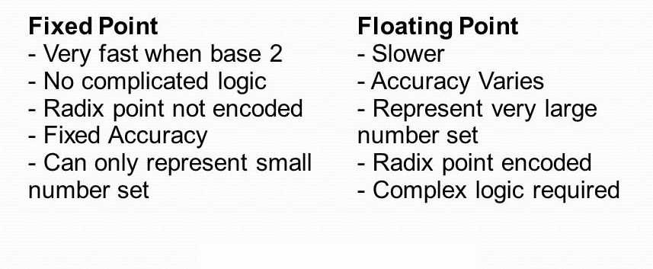

Slide 63
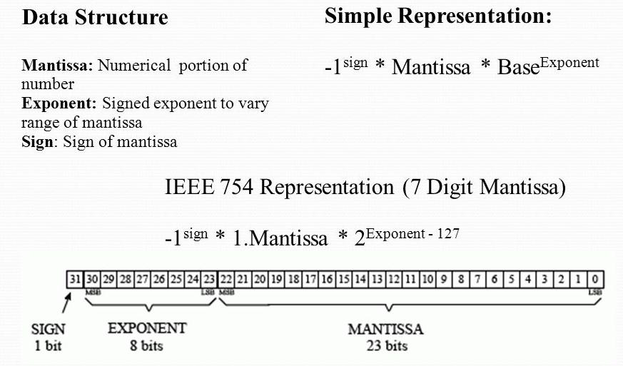

Slide 64
Overflow and underflow are both errors resulting from a shortage of space. On the most basic level, they manifest in data types like integers and floating points.

Slide 65
Overflow indicates that we have done a calculation that resulted in a number larger than the largest number we can represent. Let’s look at an example involving unsigned integers.

Slide 66
Lets assume we have an integer stored in 11 byte. The greatest number we can store in one byte is 255255, so let’s take that. This is 1111111111111111. Now, suppose we add 22 to it to get 0000001000000010. The result is 257257, which is 100000001100000001. The result has 99 bits, whereas the integers we are working with consist of only 88.

Slide 67
Underflow is a bit trickier to understand because it has to do with precision in floating points. Again, due to the discrete nature of storage in computers, we cannot store an arbitrarily small number either. The floating-point convention comes up with techniques to represent fractional numbers. When we use these in calculations that result in a smaller number than our least value, we again exceed our designated space. Without going into details of floating-point representation, we can see how this problem would manifest by considering a decimal example.

Slide 68
Suppose we are given designated boxes to write decimal numbers in. We have one box on the left of the decimal point and three boxes on the right. So, we can easily represent 0.0040.004. Now, we want to perform a calculation, 0.004 times 0.0040.004×0.004. The answer to this is 0.0000160.000016, but we simply do not have this many places available to us. So we discard the least-significant bits and store 0.0000.000, which is quite obviously an erroneous answer.

Slide 69
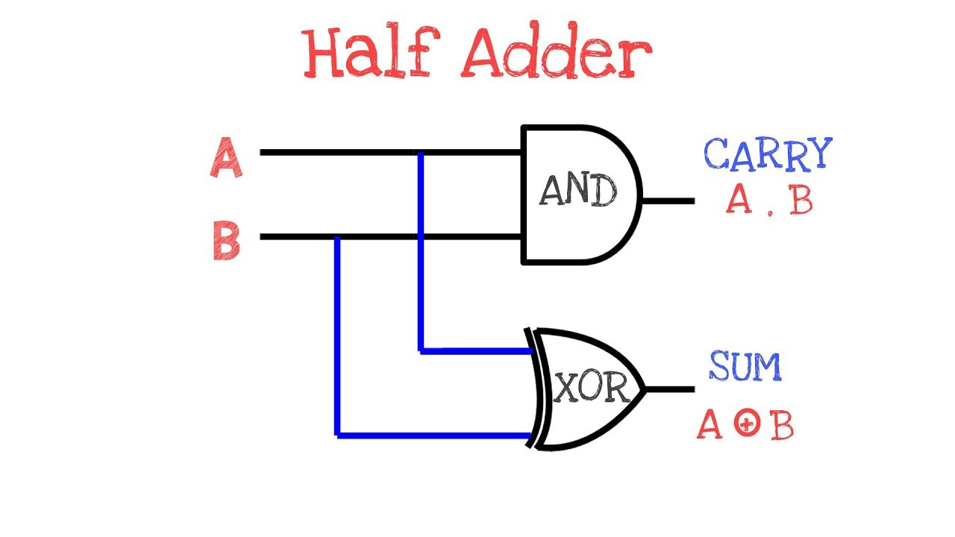

Slide 70
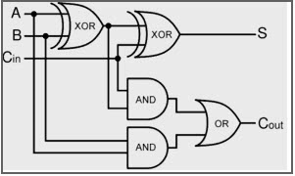

Slide 71
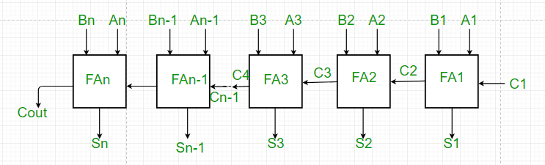

Slide 72
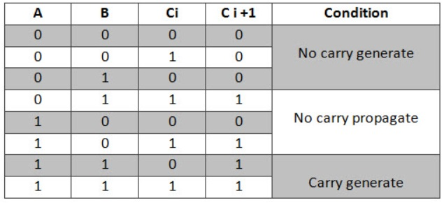

Slide 73
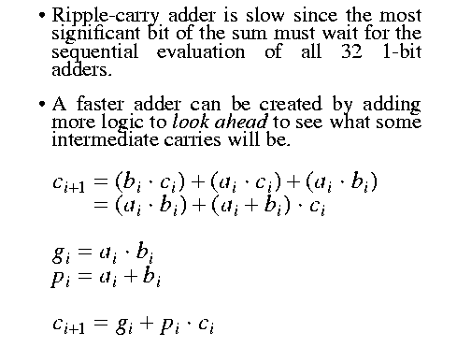

Slide 74
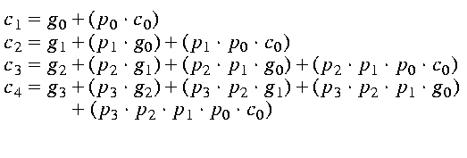

Slide 75
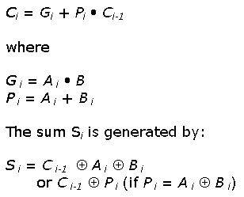

Slide 76
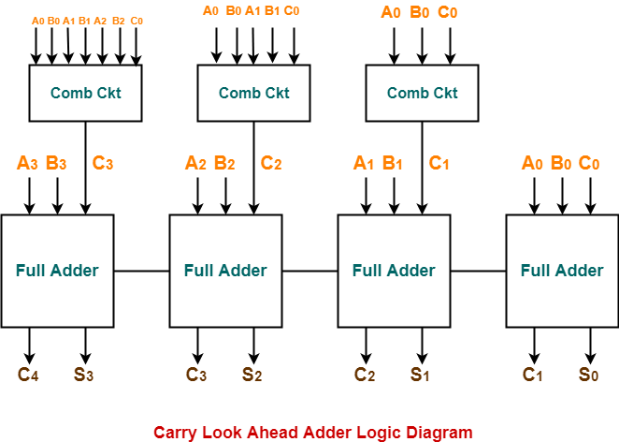

Slide 77
Explain different types of addressing modes used in instruction set design
Explain with basic timing diagram Fetch, Decode and Execute cycles in a Computer
Explain the operation of a Carry look ahead adder with suitable block diagram and equations
Give examples of one, two , theree address instructions with proper opcode formats. State the purpose of clocks in a computer
Draw the time diagram for memory write operation and explain it. Discuss the role of the operating system. A digital computer has a memory unit with 24 bits per word. The instruction set consists of 150 different operations. All instructions have an operation code part (opcode) and address part (allowing for only one address). Each instruction is stored in one word of memory. Calculate the total number of bits for opcode.
State the advantages and disadvantages of machine level, assembly level and high level language. Explain Why does increasing the amount of data that can be stored in a processor’s register file generally increase the performance of the computer?
Explain how OS performs I/O management, Disk management and protection and security.
Sketch a block diagram to illustrate the basic organization and explain the function of various units of a computer.
Define the characteristics of a modern digital computer
Evaluate different types of human resources associated with a modern digital computer
Analyze components of a modern digital computer
Explain different types of layers in a computer system.
Explain the differences between compiler and interpreter.
differences between assembly and machine languages
differences between assembly and high level language
differences between high level and machine languages
differences between multiprocessing and multitasking OS

